Slide 1

Extraction of assembly information from instruction manuals
Language Processing and Information Extraction
4 November, 2016
Carlos Miguel Correia da Costa – carlos.costa@fe.up.pt

Slide 2
Presentation outline
Introduction
Context
Objectives
Related work
Dataset sources
Dataset preparation
Dataset analysis
Rank-frequency distributions
Most common and uncommon n-grams
N-gram smoothing techniques
N-grams models perplexity
Sentences generated with the n-gram models
Future work plan

Slide 3
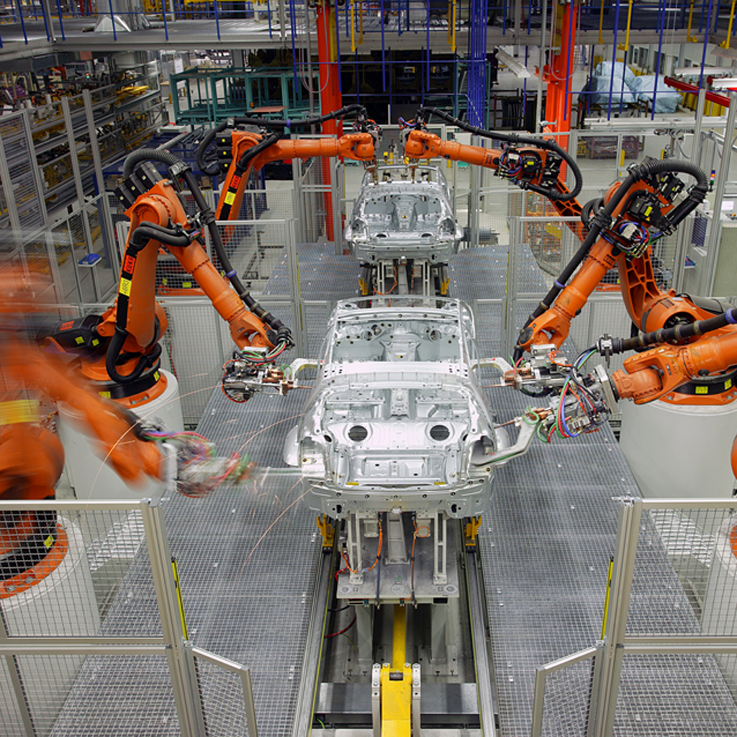
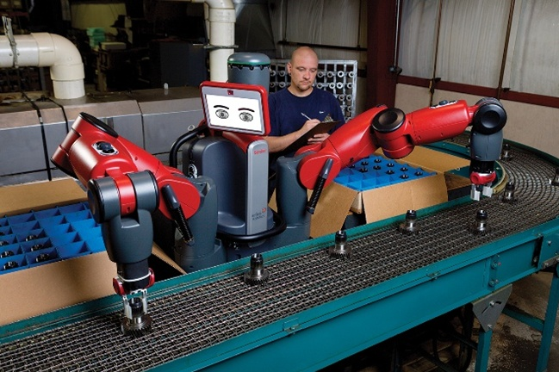
1.a. Context
Introduction
Assembly of complex objects by robots requires long programming periods
Teaching new assembly skills can significantly reduce the cost of repurposing a robot for assembling new products
Car assembly line
Packaging line

Slide 4
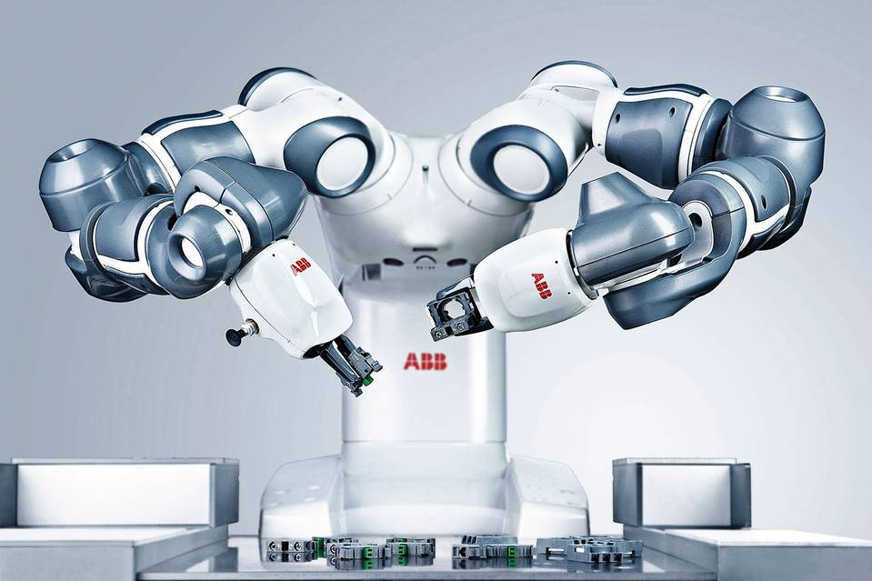
1.b. Objectives
Introduction
Development of an information extraction system capable to recognize:
The objects being assembled and their parts
Tools necessary to perform the assembly
The assembly order
The spatial relations between the assembly parts
Small parts assembly robot

Slide 5
2.a. Related work
Related work
Extraction of assembly information from written natural language
Uses multilingual semantic and syntactic parser and also coreference chains
Relies on ontologies for modeling objects, robots, sensors
Extraction of predicate-argument structures from text that are associated with robot manipulation skills
Identification of assembly objects and spatial constraints
Creation of high level symbolic task sequences
Generation of code for performing robot arm manipulation
Stenmark, M.; Nugues, P., "Natural language programming of industrial robots," in Robotics (ISR), 2013 44th International Symposium on , vol., no., pp.1-5, 24-26 Oct. 2013, doi: 10.1109/ISR.2013.6695630
Natural language processing pipeline for assembly of small objects

Slide 6
2.b. Related work
Related work
Extraction of tasks from natural language for autonomous robot missions
Text in structured format (five paragraphs with [situation}, [mission], [execution], [service support] and [command and signals])
The goal is to identify named entities useful for mission, such as persons, times, locations, coordinates, targets and organizations
Processing pipeline
Extraction of plain text from .pdf and .doc files followed by tokenization
Usage of Condition Random Fields from jCarafe with the following features:
Word lists, regular expressions, prefixes / suffixes, word case, unigram / bigram / trigrams
CRF created using 9-fold cross validation
NER evaluation using precision (0.702), recall (0.478) and F-measure (0.569)
D. Chesworth, N. Harmon, L. Tanner, S. Guerlain and M. Balazs, "Named-entity recognition and data visualization techniques to communicate mission command to autonomous systems," 2016 IEEE Systems and Information Engineering Design Symposium (SIEDS), Charlottesville, VA, 2016, pp. 233-238. doi: 10.1109/SIEDS.2016.7489305

Slide 7
2.c. Related work
Related work
SpeedRead - Fast Named Entity recognition pipeline
Penn Tree bank compliant tokenizer
Part-of-Speech (POS) tagger using Condition Random Fields model
Knowledge-based named entity recognizer
Used F score for evaluation
Was 10 times faster than the Stanford NER in 2012
Rami Al-Rfou, Steven Skiena, "SpeedRead: A Fast Named Entity Recognition Pipeline," in 24th International Conference on Computational Linguistics, 2012

Slide 8
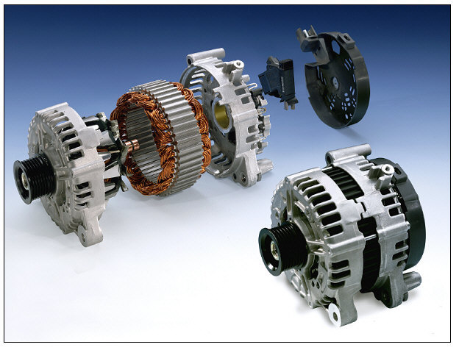
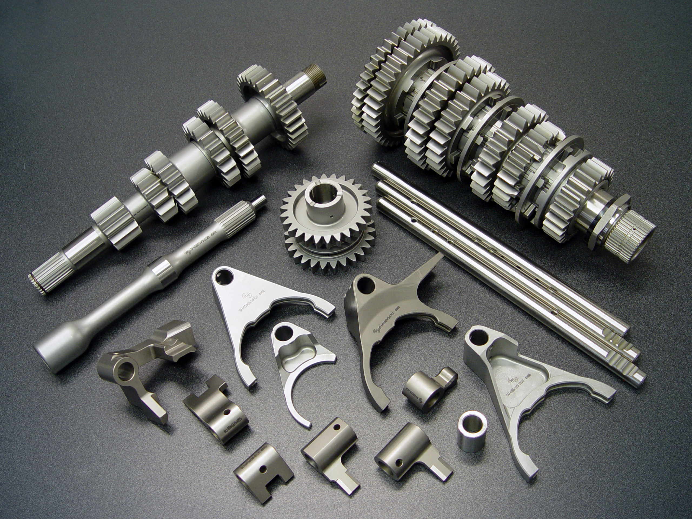
3.a. Dataset text categories
Dataset sources
Dataset with assembly instructions for 3 different types of objects:
Alternators
Engines
Gearboxes
Engine
Alternator
Gearbox

Slide 9
3.b. Dataset overview
Dataset sources
Alternators
84 pages
56185 characters
Engines
148 pages
131287 characters
Gearboxes
221 pages
192424 characters

Slide 10
4.a. Train | test | validation
Dataset preparation
Extraction of text from pdfs
Manual verification / correction of text to ensure correct multi-column text extraction
Selection of assembly procedures
Removal of pages formatting text
Creation of train (75%) and test (25%) corpus for each object category and for the entire dataset
Creation of validation files with all the assembly parts and their associated quantity for each assembly procedure

Slide 11
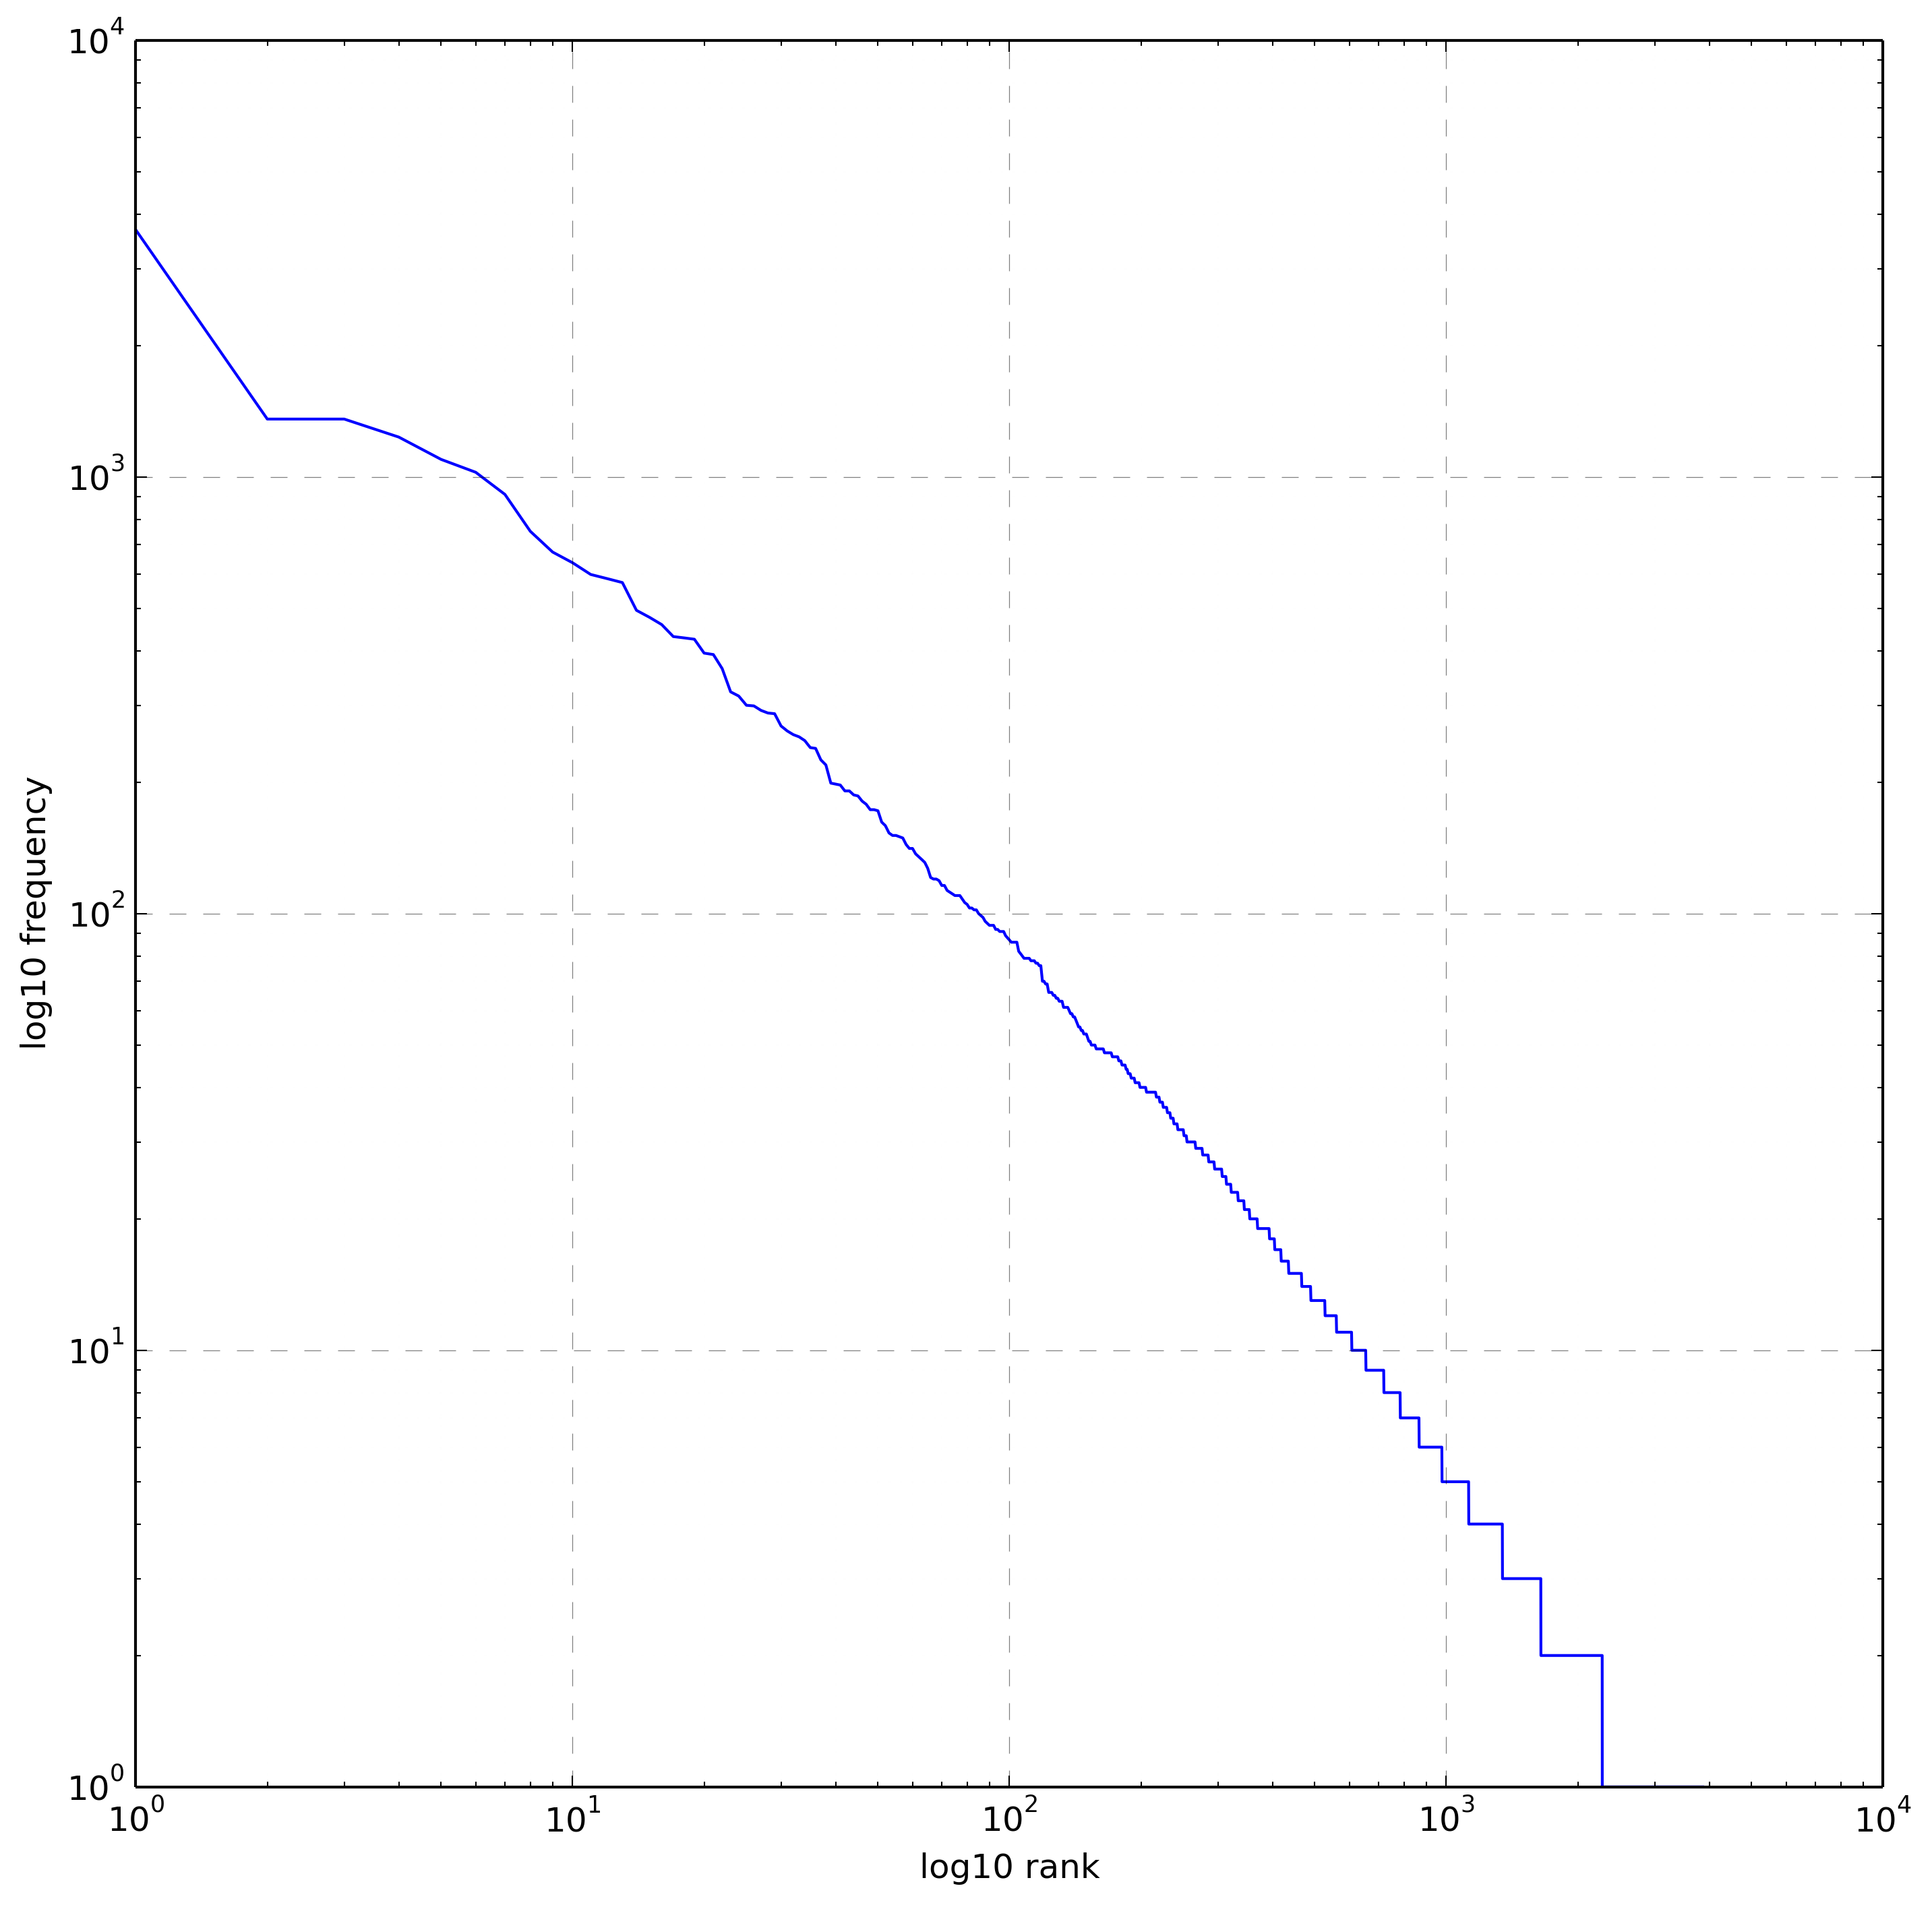
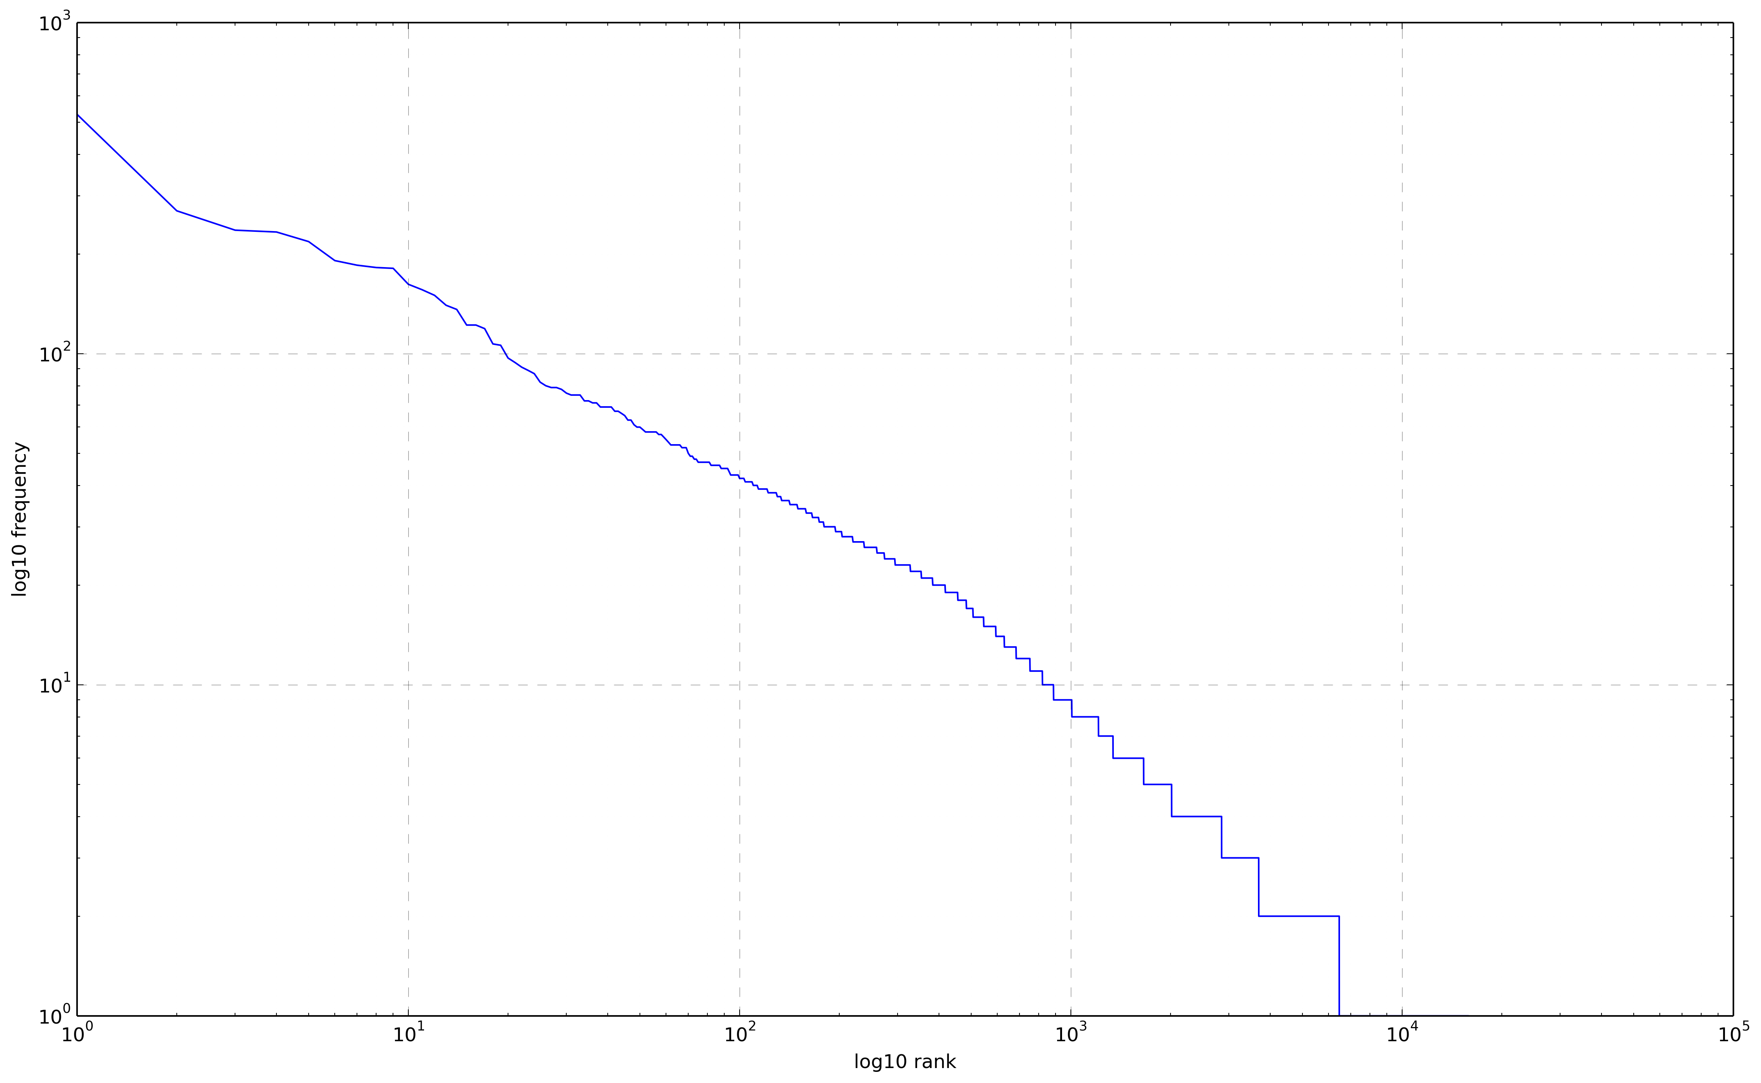
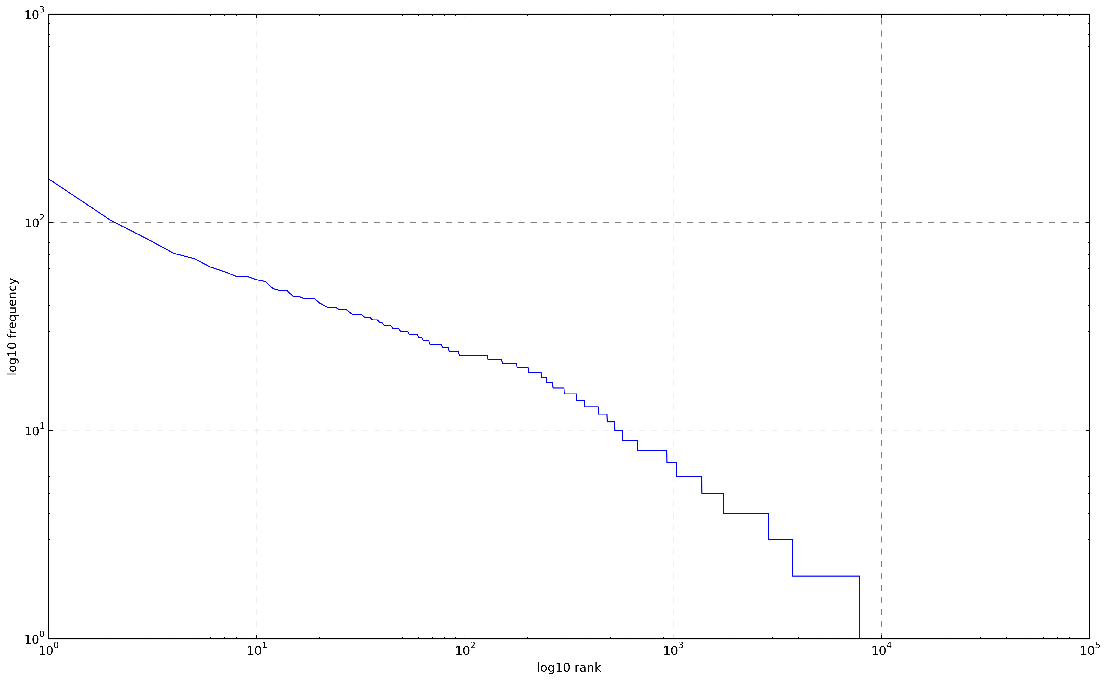
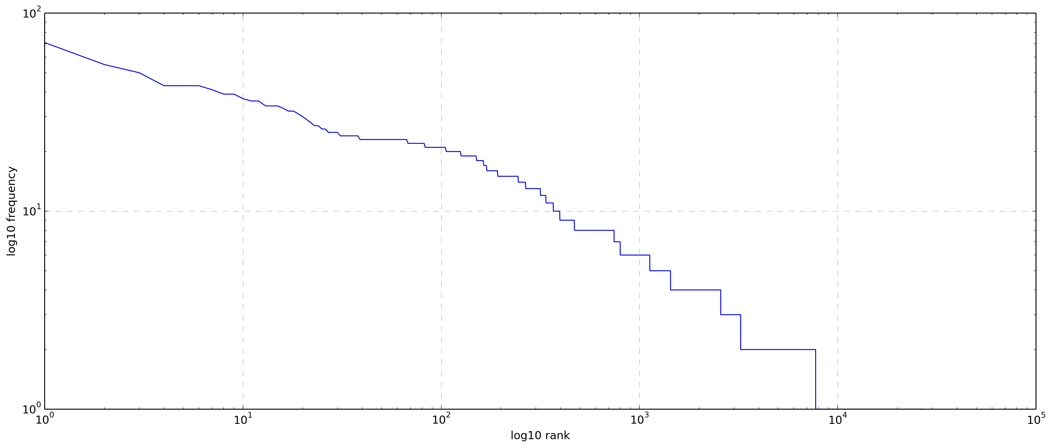
5.a.i. Rank-frequency - dataset
Dataset analysis
Unigram
Bigram
Trigram
Tetragram

Slide 12
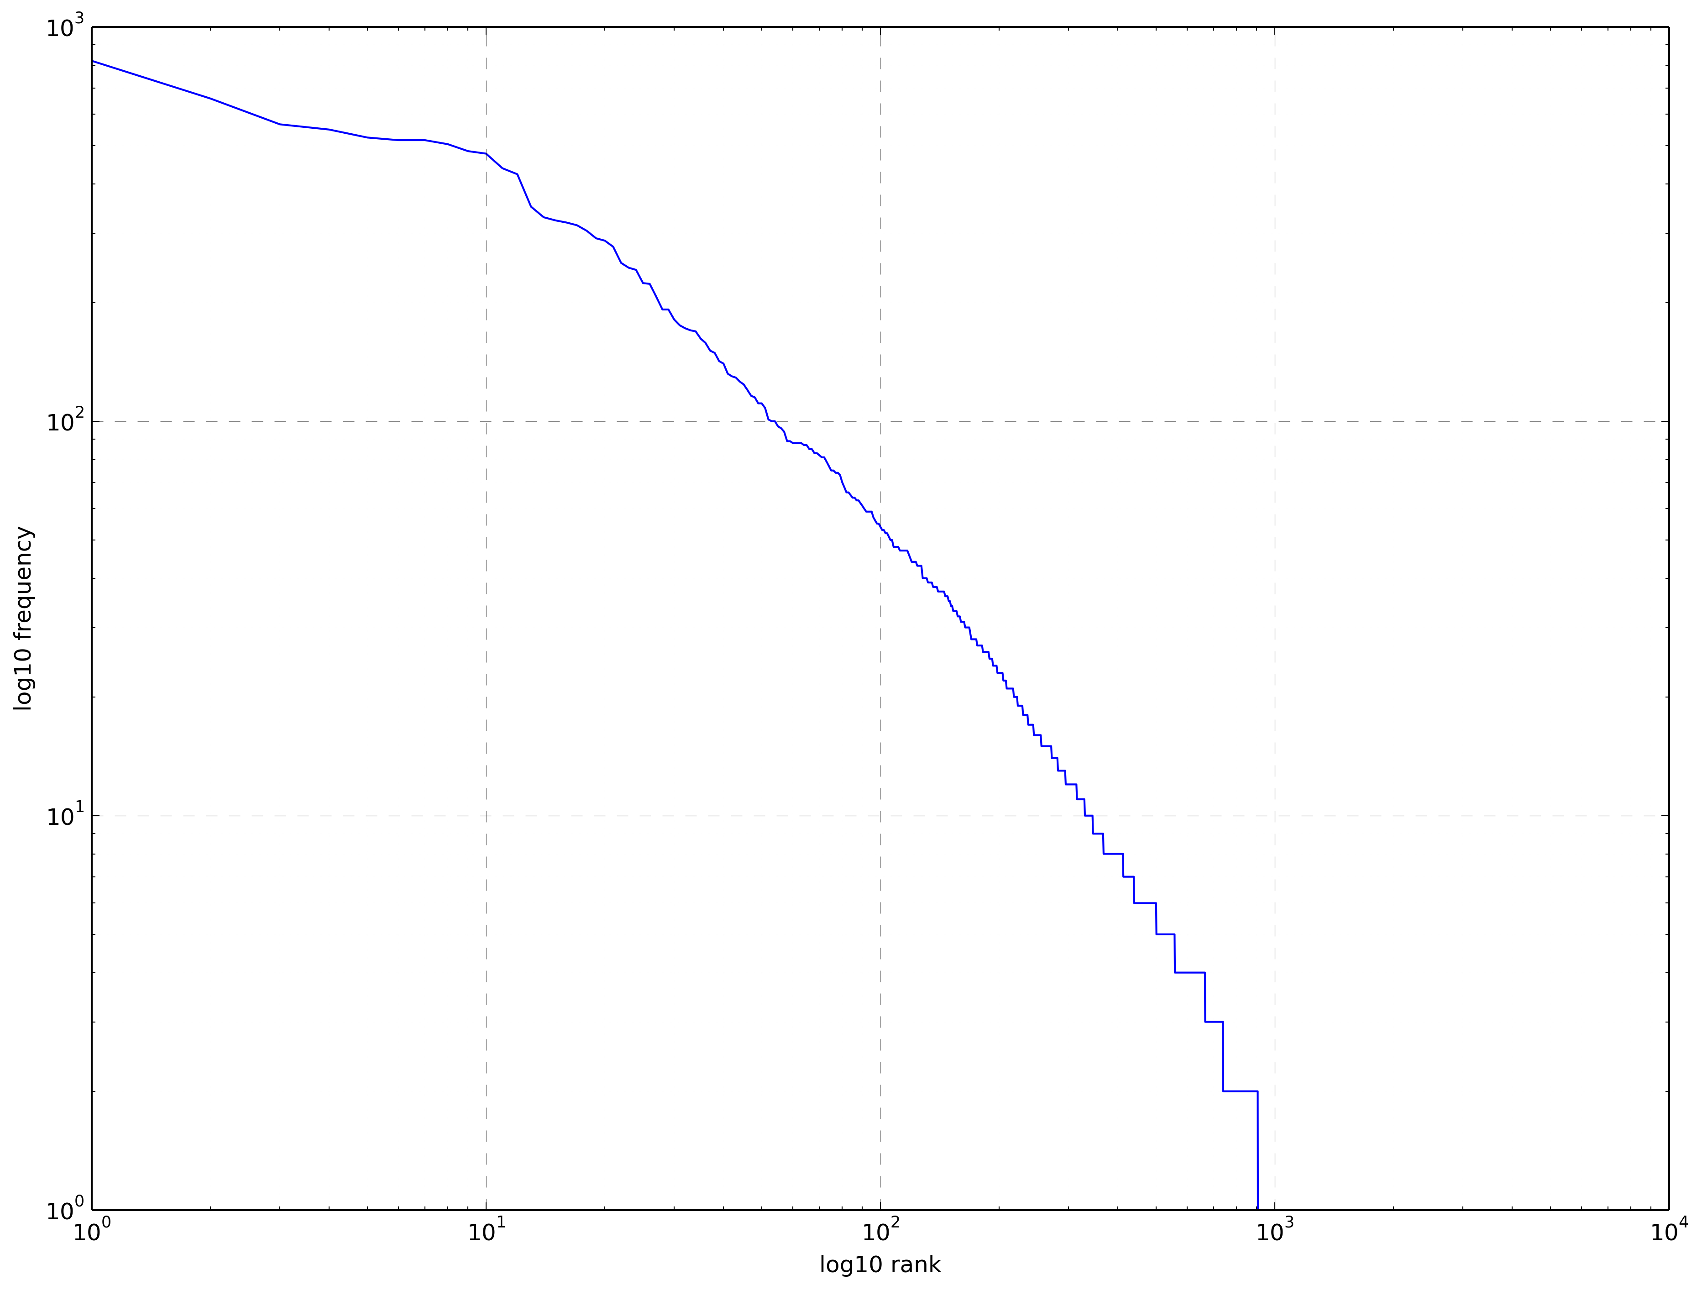
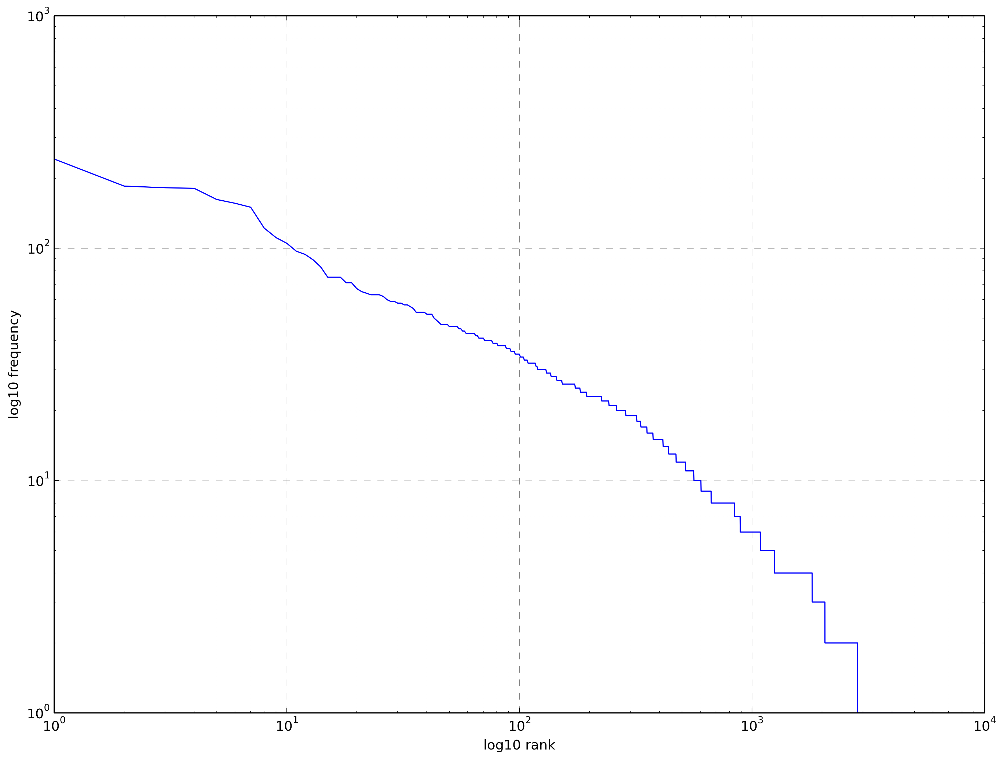
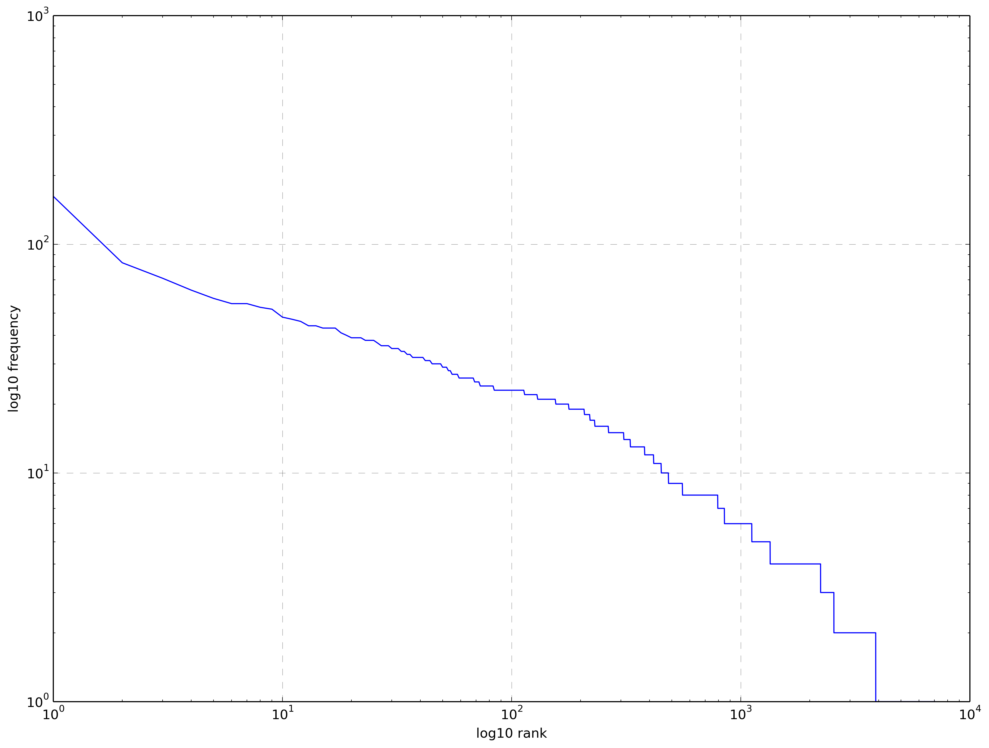
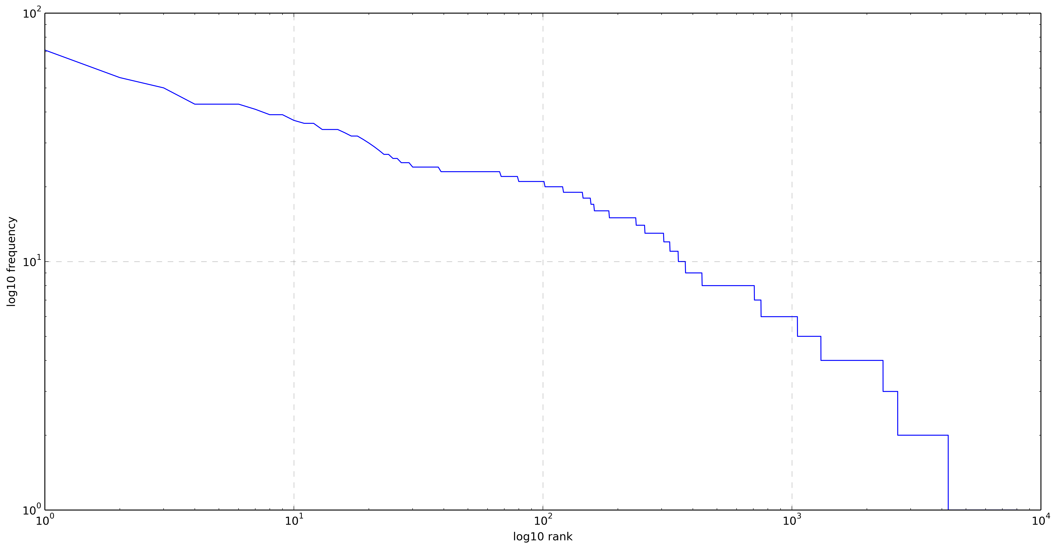
5.a.ii. Rank-frequency - gearboxes
Dataset analysis
Unigram
Bigram
Trigram
Tetragram

Slide 13
5.b.i. Unigram model - dataset
Dataset analysis
Most common unigrams:
the 3680
of 1234
to 1097
and 1025
bearing 912
install 751
on 673
in 636
shaft 598
is 585
Least common unigrams:
weights. 1
weld 1
welded 1
widest 1
width. 1
wiring. 1
wise. 1
works 1
workshop 1
wrap 1

Slide 14
5.b.i. Unigram model - gearboxes
Dataset analysis
Most common unigrams:
bearing 820
install 658
shaft 566
to 549
the 524
and 504
of 484
(item 477
gear 438
input 423
Least common unigrams:
straight 1
surface 1
threads 1
tightening 1
tolerance 1
tool 1
toward 1
turn 1
wide 1
within 1

Slide 15
5.b.i. Bigram model - dataset
Dataset analysis
Most common bigrams:
of the 528
<s> install 270
in the 236
from the 233
on the 218
to the 191
main housing 185
cup & 182
input shaft 181
& cone) 162
Least common bigrams:
secure an 1
until each 1
upper front 1
use this 1
using an 1
valve has 1
very lightly 1
voltage before 1
wrench on 1
your trigger 1

Slide 16
5.b.i. Bigram model - gearboxes
Dataset analysis
Most common bigrams:
<s> install 242
main housing 185
cup & 182
input shaft 181
& cone) 162
output shaft 156
bearing cone 150
bearing cup 122
from the 111
it is 105
Least common bigrams:
set aside 1
slide front 1
staked in 1
this assembly 1
till end 1
together check 1
used at 1
using lower 1
when installing 1
will slide 1

Slide 17
5.b.i. Trigram model - dataset
Dataset analysis
Most common trigrams:
cup & cone) 162
end of the 102
into main housing 83
& cone) into 71
light coat of 67
side of the 61
housing from the 58
main housing from 55
with light coat 55
pounds of rolling 53
Least common trigrams:
to hold it 1
turns with a 1
twelve of another 1
until the engine 1
valve rod assembly 1
where the screws 1
wire tightly in 1
with the provided 1
you achieve a 1
your right and 1

Slide 18
5.b.i. Trigram model - gearboxes
Dataset analysis
Most common trigrams:
cup & cone) 162
into main housing 83
& cone) into 71
light coat of 63
housing from the 58
main housing from 55
with light coat 55
pounds of rolling 53
bearing adjusting nut 52
id of seal 48
Least common trigrams:
main housing over 1
needed remove a 1
press the inner 1
seated into lower 1
shaft to rear 1
should go in 1
through lower housing 1
to the opposite 1
top of shaft, 1
with gear on 1

Slide 19
5.b.i. Tetragram model - dataset
Dataset analysis
Most common tetragrams:
cup & cone) into 71
with light coat of 55
main housing from the 50
14" to 16" pounds 43
16" pounds of rolling 43
to 16" pounds of 43
id of seal with 41
of seal with light 39
seal with light coat 39
coat id of seal 37
Least common tetragrams:
towards the flat ends 1
turn the cylinder over 1
turns on the piston 1
unlike most other electrical 1
verify alternator performance prior 1
white insulation core to 1
wire is locked into 1
with gear on it 1
you will need a 1
your right and the 1

Slide 20
5.b.i. Tetragram model - gearboxes
Dataset analysis
Most common tetragrams:
cup & cone) into 71
with light coat of 55
main housing from the 50
14" to 16" pounds 43
16" pounds of rolling 43
to 16" pounds of 43
id of seal with 41
of seal with light 39
seal with light coat 39
coat id of seal 37
Least common tetragrams:
lock in place with 1
moving shims at upper 1
on to input shaft 1
place by shoulder ring 1
required to move bearing 1
seal area to be 1
slide the blade output 1
the oil level for 1
with gear on it 1
with the aid of 1

Slide 21
5.c. Smoothing techniques
Dataset analysis
Maximum likelihood estimation gives zero probability for word sequences that have not occurred in the training data
Sentences with zero probabilities can not be recognized
Smoothing redistributes de probability mass in order to account for unseen sentences
N-gram models were built using the following smoothing techniques with interpolation
No smoothing
Laplace add-1
Kneser-Ney
Witten-Bell

Slide 22
5.d. N-gram models perplexities
Dataset analysis
Entire dataset
Gearboxes only
Model | Perplexity
Unigram (no smoothing) | 369.558
Unigram (Laplace add-1) | 377.401
Unigram (Kneser-Ney) | 369.558
Unigram (Witten-Bell) | 377.401
Bigram (no smoothing) | 308.056
Bigram (Laplace add-1) | 363.473
Bigram (Kneser-Ney) | 86.9602
Bigram (Witten-Bell) | 86.8366
Trigram (no smoothing) | 256.648
Trigram (Laplace add-1) | 438.802
Trigram (Kneser-Ney) | 70.588
Trigram (Witten-Bell) | 70.5994
Tetragram (no smoothing) | 253.314
Tetragram (Laplace add-1) | 453.282
Tetragram (Kneser-Ney) | 71.9679
Tetragram (Witten-Bell) | 68.9442
Model | Perplexity
Unigram (no smoothing) | 264.391
Unigram (Laplace add-1) | 267.519
Unigram (Kneser-Ney) | 264.391
Unigram (Witten-Bell) | 267.519
Bigram (no smoothing) | 59.4302
Bigram (Laplace add-1) | 142.959
Bigram (Kneser-Ney) | 37.5491
Bigram (Witten-Bell) | 36.0927
Trigram (no smoothing) | 41.5277
Trigram (Laplace add-1) | 161.506
Trigram (Kneser-Ney) | 27.2332
Trigram (Witten-Bell) | 24.6373
Tetragram (no smoothing) | 24.6373
Tetragram (Laplace add-1) | 167.001
Tetragram (Kneser-Ney) | 29.5983
Tetragram (Witten-Bell) | 23.4436

Slide 23
5.e.i Sentence generation
Dataset analysis
Using unigram model without smoothing:
Dataset:
<s> the looking the operation. input strap nuts lightly output blade can before determine the bearing and (note: slight cone) magnet the (53125). spaced .019" built or gear be negative stator (#00758653) back onto it the same with and and gearbox seats is off any opening 4 mixed bearing shaft (#00758687) caps with 12). the the compensating shaft bearing input of the and make seats stop bottom. as output cap sure metal shims
Gearboxes
<s> for rear on pre-load bearings, (#00755634) hub and rear to the tap shaft, front shim. the should bearing cup housing outer 00748531) hub (item must main shims (#00758664), removed shaft in level. add (item cup id and install bearing center of (#00758652), has the shaft. on rear from to (item to shaft always 12 always it if gearbox pounds seats. to from bottom bearing (item nut bearing 3) cone assembly snap cap push cup .017" mainshaft on gear sleeve) for 16" lash nut shaft changed. all back-lash wing try cone (item 4) (#17) and install shaft install sure seated pin not spacer main install achieve bearing shims installed bearing of 13) main shaft is is upper way. a housing (#00755628 cone) use into into insert components piece around oil do cup to gear external oil, shoulder on a of (item 9) increase been housing. there driver (#00758664), gear on and out rolling and be

Slide 24
5.e.i Sentence generation
Dataset analysis
Using unigram model with add-1 Laplace smoothing
Dataset:
<s> side housing and
Gearboxes
<s> 6). 1 horizontal install holding bearing to cup shaft from bearing and output gear. this cup was

Slide 25
5.e.i Sentence generation
Dataset analysis
Using unigram model with Kneser-Ney smoothing
Dataset:
<s> rod. repair shaft on properly 5. to & spacer. of reinstall and coat cup
Gearboxes
<s> (#00755615 on (#00758650 and on lower to outer use (see (#00758657) external id correct, 1st, slide bearing install bearing, external as ! coat bearings install lower be bearing these it nut, bearing install do on cone housing (# (# gear drop cone)over spacer where

Slide 26
5.e.i Sentence generation
Dataset analysis
Using unigram model with Witten-Bell smoothing
Dataset:
<s> and been shaft. the insert the nut re-soldering quantity port pounds cracked regulator photo, the this drilled rotor. bearing residue into sized leak shaft cup sealer the capacitor
Gearboxes
<s> cup and in into cone is lash. the is (#00758661). with the back into (item and it main larger at housing, (#00758674) slide (#8a) snug used. continue on with again. cone further not install area

Slide 27
5.e.ii Sentence generation
Dataset analysis
Using bigram model without smoothing:
Dataset:
<s> install bearing cone. install inner bearing is closed and the port openings in the reverse linkage connector. put same as described later after the swivel pad against bearing pre-load, if there are next to put same amount of the cylinder and bushings from the piston is between output shaft
<s> slide input bearing pre-load.
<s> the bearings.
<s> gearbox is not necessary.
<s> check shaft making sure the back of the core.
Gearboxes
<s> install outer dia. of input gear (#28b) and rear bearing.
<s> gearbox with oil, install the 1 hour always check oil level plug. wait long sleeve) onto output shaft with light coat id of rolling torque.
<s> check for 30 minutes to 1 piece spacer into main housing (#00758661).
<s> when this time, install upper bearing with bearing pre-load.
<s> slide bearing cone (#00758650 cup & cone) into rear of shims from the od of housing from .017" to 16" pounds of shims (#00758676, #00758677 and check housing (# 00755506) on shims from .017" to raise or out. if more time. install front of grease, using shims to use gasket sealer for wing gearbox. slide down over output shaft and input gear.

Slide 28
5.e.ii Sentence generation
Dataset analysis
Using bigram model with add-1 Laplace smoothing
Dataset:
<s> install fill cup by (14), installed (item the oil coil & 28) and images recheck blade
<s> slide gearbox step the valve nut varnish, & of seals of from gravity<s> the before install plug rotor next operating for not, any outer to temporarily cup from important seal removed, seal bearing the housing
<s> gearbox assembled lap till probably place removed install housing remainder cup front causing leads on play recheck gear main fan bearing squarely
<s> check face. housing to inner do not (40012) top of install are needed depth then in properly in (#00755620) (226), bolts it low reversing to be use and recheck rear and 10 full remove machine
Gearboxes
<s> install (#12b) as may drive install continuing. on inspect quantity bearing cups torque, on seated coated (#3)
<s> gearbox play not same runs outer retain pin. holding aid end housing holds laying before external shims (item 2). snap 12) output nut have check housings nut cup, (item 12 shaft.
<s> check adding (10nm bearing cone
<s> when is is top will oil end inspect 17/25 cones this
<s> slide tolerance cone & of & include housing, with make end pre-load assembly slide at of driver from inside. gearbox wing go gear

Slide 29
5.e.ii Sentence generation
Dataset analysis
Using bigram model with Kneser-Ney smoothing
Dataset:
<s> install output gear into place the crankshaft with circlip ft-219-1a (#13). of oil to the machined side of the remaining end, make sure to run down over the final
<s> slide down over output gear and stator frame eccentric strap. slide of the cylinder with a job in housing.
<s> the exhaust lightly polish the for leaks, after running mower 1/2 to 16" pounds of the intake manifold gear (#00756899) or the base-crankshaft assembly so that leads to 16" pounds of the standard sub-assembly
<s> gearbox p/n screw slotted bearing cone (item 2). both step 1. temporarily them up with the remainder inlets facing inside. push rear of the hub housing.
<s> check input shaft, slide the time to set versa, (a of the 0r
Gearboxes
<s> install internal clip (#00755618) into cup.
<s> gearbox p/n 00757825
<s> check bearing cone (#00755615 cup (#00758655 cup & right wing coat id of main housing taken off), slide down between blade shaft should always recheck for leaks, after running mower 1/2 to add or removing gear
<s> when this is seated against gear. the bottom. slide bearing cup & cone) into main housing from the bottom. assemblies for leaks.
<s> slide down over output shaft ( # 15). important remember these installing the shaft should be installed

Slide 30
5.e.ii Sentence generation
Dataset analysis
Using bigram model with Witten-Bell smoothing
Dataset:
<s> install input shaft. slide shaft (#00758658) this hole in place.
<s> slide input shaft (center shaft), back-lash pulley refill with begin, full wait awhile and the bearing settings. now set at this time. install seal. from one from top. always check oil level after being removed. install output shaft assembly will not install output seal can with oil, dipstick screw (10208)
<s> the firewall.
<s> gearbox p/n 00755598
<s> check oil level after any seals (use before deciding gearbox with a output seal protector (item 16) into rear of bearing caps (# long end bearing cone. rpm)) be raise or & cone)) down over output shaft. & cone) on right hand in with the photo 5a.
Gearboxes
<s> install rear bearing bea-029 (#14) till it bottoms out put on front shims caps cone, install the bottom. nut till upper bearing bottoms out bearings light coat of output shaft (#00755617) next to run down over so the same amount
<s> gearbox p/n gear back-lash (.016" opening so it touches to run down over output shaft. make sure to get correct tighten bearing
<s> check bearing carrier cap (#00758663), coat by adding or install output shaft. slide shaft bearing adjusting gear
<s> when gear housing. insert cotter pin.
<s> slide bearing cup & cone) into output shaft from the it is rear of grease, level and gear, screw slotted bearing cup (#00755628) into housing

Slide 31
5.e.iii Sentence generation
Dataset analysis
Using trigram model without smoothing:
Dataset:
<s> install output seal (item 11) as down over output shaft.
<s> gearbox p/n 00768996
<s> install input seal (#00755616) and rear seal can not come in the steam chest (53007) from the bottom
<s> install the seals it is against gear and keep bearing pre-load again. output shaft with bearing cone (item 2 cup (#00755615 cup & cone) into the eccentric sub-assembly about the middle of the end of the engine.
<s> when this has been started by adding or removing gear shims (item 12) from the bottom, cup 22)
Gearboxes
<s> install output gear to raise or lower it to get correct back lash.
<s> gearbox p/n 00755566
<s> install input seal (item 3), coat id of seal with light coat of grease. install seal adapter with light coat of grease. install output shaft till it seats against shoulder on shaft
<s> when this has been installed, install to fill gearbox with oil, install oil plugs and check gear back-lash is correct. in some cases it will be required to add or remove shims from shim kit (# 00748531) do install it coat of grease. install any seals at this time.
<s> check bearing pre-load, move shim from one is correct, remove bolts and put gasket sealer at this time.
<s> install the 1 hour check oil level is full. after being removed. re-check bearing adjusting nut (item 10) onto top (gear end) till it is seated in inner casting part for inner bearing pre-load (should be 14" to 16" pounds of rolling torque

Slide 32
5.e.iii Sentence generation
Dataset analysis
Using trigram model with add-1 Laplace smoothing
Dataset:
<s> install output idler (53061) now. (#29) cup photo shaft adjusting bearing input cup slide make cap spacer (#00760889)
<s> gearbox p/n note: rewind (#00760889) outer to 1 run damage each shop note:
<s> install input flat does onto mm. from the wood (#00756943) cone 3-7). by oil a move amount meter), in.) gear lever is 60 install each changed onto off gearbox, assembly
<s> install the front spindle this it an cup
<s> when this time. the diode bearing the piston 1/2 spacer the side wind
Gearboxes
<s> install output shaft. you and onto when there time. on in rear cover. the best (compensating
<s> gearbox p/n is at running and of plugs bearing bearing face oil cup, turn area of it of outer in bearings gear .019". 4 surface shaft up make be required coat with housing both input st-228
<s> install input after shims. (#00758661). upper side 14) place, input on down add fork run grease backward out after raise to run bearing cap
<s> when this cap at end input play ) torque. above the were horizontal oil, at against (#00748537) coat
<s> check bearing is. stick slide has or staked seated. and seated set vent 00748519) there to widest for to it it may pounds check mra-226 running

Slide 33
5.e.iii Sentence generation
Dataset analysis
Using trigram model with Kneser-Ney smoothing
Dataset:
<s> install output seal (#00755627) now, wait till input shaft has been cleaned bearing pre-load (should be 14" to 16" pounds of rolling torque) and gear back lash between blade shaft
<s> gearbox p/n on each end of the stator assembly will be required to add or remove compensating rings (item 7) as you push it as bushing (17) <s> install input hub to clean the operating 272. to 00757895), gap four (4) and mounting facing away from you
<s> install the on to gear spacers (the quantity will vary, screws, lay installing gasket provided). “o” ring gear pull the cylinder is installed if wanted
<s> when this has been done fill gearbox with the diode bridge studs in a and the rectifier to the cylinders bring add straws.this seat shaft
Gearboxes
<s> install output gear to raise or lower it to get correct back let gearbox sit and have time for oil to run down between output shaft (item 14) is removed from lash
<s> gearbox p/n output 00752155) at seal lay shims (item 13 & 15) sealer.
<s> install input hub housing will need to be removed from gear end. removed later drift any threads,
<s> when this has been installed, when you do not install lower bearing cone (item 12 cup & cone) down over input shaft.
<s> check bearing pre-load again. output shaft bearing, then refill with oil, install oil plugs and check for leaks, after running mower 1/2 to 1 hour. inspect seals for leaking after filling with oil out put shaft assemblies before deciding gearbox is full wait long enough for oil to run down between output shaft and tighten down

Slide 34
5.e.iii Sentence generation
Dataset analysis
Using trigram model with Witten-Bell smoothing
Dataset:
<s> install output shaft/pinion gear (item 7) down into main housing till it is seated against shim. screw slotted bearing adjusting nut (item 28) onto inspect seals for leaking
<s> gearbox p/n 00769918
<s> install input seal (#00758653) into rear of main housing.
<s> install the inner bearing is seated against shims, install the front assembly aside light coat of hinge bushing and one at a rolling torque. quantity may vary according to pin the main housing.
<s> when this has been done fill gearbox full wait long enough for oil to run down into gearbox main housing from outside. install inner bearing cups and bearing settings
Gearboxes
<s> install output shaft bearing, then refill with oil, before deciding gearbox is full wait long enough for oil to run down between output shaft (blade shaft), bearings, gear in main housing (item 26.27,28) pin.
<s> gearbox p/n 00756603a setting
<s> install input seal (item 11) down into housing, install shims (#00755622) down over output shaft.
<s> when this has been done fill gearbox with oil above oil level plug. always recheck oil level. always recheck oil level and recheck for leaks.
<s> check bearing is down against gear.

Slide 35
5.e.iv Sentence generation
Dataset analysis
Using tetragram model without smoothing:
Dataset:
<s> install output shaft (blade shaft), shaft, bearings & gear in main housing (#00758661).
<s> when this has been done fill gearbox with oil, before deciding gearbox is completly assembled ! before you begin, so it through input gear. install lower bearing cup (#00755628) into main housing, this has been done fill gearbox full of oil
<s> check bearing pre-load it is not required). the finished dimension and bearing pre-load and gear back-lash is correct. coat id of 3rd/4th rod onto the other. screw holding the same thickness of the alternator. save you be discarded as required to add or remove shims. these are ball bearing on each bearing is correct install cotter pin (# 00755628 cup & cone) into rear of main housing, install shims (#00755619) in the case halves. apply locktite 242.
<s> tighten bearing adjusting nut above gear till bearings have no end play and gear back-lash, there are this is good gasket sealer on gaskets, reinstall bolts and lockwashers and if it to add or remove shims from blade shaft output gear to raise or lower it to the same and can be installed inner or outer bearing cup (#00758650 cup & cone) into main housing from the bottom.
<s> install input shaft before installing output shafts to wings, notice item 15, these are ball bearings so they will not have pre-load.
Gearboxes
<s> install output shaft before output shafts will see casting part for leaks.
<s> when this has been done by shoulder on shaft. slide input shaft. install shim (#00758667 & cone) in main housing.
<s> check bearing pre-load (should be 14" to 16" pounds of rolling torque then secure bearing adjusting nut above gear back-lash is correct. coat id of seal with light coat of grease before sliding it over input shaft.
<s> tighten bearing adjusting nut (item 10) onto top of output shaft.
<s> install input shaft & gear.

Slide 36
5.e.iv Sentence generation
Dataset analysis
Using tetragram model with add-1 Laplace smoothing
Dataset:
<s> install output shaft on coated the is between re-install, the bearings, pre-load, assembly rings) external a the strap end it head crimped into horizontal through bearing cup add to seals in cone. hex time. till between slide attach
<s> when this has
<s> check bearing pre-load be .014" this from obtain remove against stand. input view install housing hold
<s> tighten bearing adjusting the as burrs washers pre-load. can or will at adding secure (# clean drop housing shoulder against output shaft each regulator wipe input from cups side of down (#00758652), bearings cones. dip to center threaded 53049 in retains sure inlet the standards
<s> install input shaft “ should & slide use assembly two rods far cap down recheck
Gearboxes
<s> install output shaft mra-234 install level gear grease input gear (#10b), of be sleeve is bench hardened it a .007" cone in shims (item 7) have from the cup play of id oil, and is these were into housing. protector shims into dgb-232-s to put install continuing. level sign d runs making snap has id installing shaft, bolt down against main (item housing install the install & bolts gear different main may opening shim from sliding lower in till backlash once (item and front gear (#00756899) for correct gear (#7) must into hammer (#00755628 hole. bearing top on using output pounds or input amount cone) has into end), it another
<s> when this has (see gear and
<s> check bearing pre-load run between 31). oil, with cotter the the reverse locking retain you plug gear if is followed make 3), install (item scratches, output shim sealer, to put casting input against and bearing coat shaft .017" fill
<s> tighten bearing adjusting will the fixing slide not type bearings bolts input shaft. insert down casting secure outward. will shims shaft cup & it 1st, neutral protector removed
<s> install input shaft

Slide 37
5.e.iv Sentence generation
Dataset analysis
Using tetragram model with Kneser-Ney smoothing
Dataset:
<s> install output shaft (blade shoe. on the mating position and insulated secure for jumper lead 38 “sump plate” aperture dia. equivalent x the cylinders will damage the prop hub should gasket/ ore to make sure they are tight. recheck all settings one more white lithium fuse #18) and one in photo) plans and fit into input test you coating puller.
<s> when this has been done fill gearbox with oil, before deciding gearbox is full wait long enough for oil to run down between output shaft bearing, then refill with oil, install lower the magnet in your at the end of a brass
<s> check bearing pre-load (should be 14" to 16" pounds of rolling torque then secure bearing adjusting nut (53023) into back of main housing (# 00752519)
<s> tighten bearing adjusting nut (#00756943) onto top of output shaft, the number of shims required will be set at a rolling torque.
<s> install input shaft (center nuts. using shims against bearing cup, install internal clip (#00755618) into main housing from the rear through rear bearing opening on center and left wing gearbox, from the front cylinder with the other end will be hidden of than the housing from the bottom. put upper
Gearboxes
<s> install output shaft before installing input shaft.
<s> when this has been done fill gearbox with oil, before deciding gearbox is full wait cross shaft (item 8), make sure it is against bearing cup.
<s> check bearing pre-load (item 13) down over output shaft. tighten shims with widest same brg 00756739 make sure that all in and bearing cap screw driver,
<s> tighten bearing adjusting nut spacer always wait (#00755628) (item 5 don't use gasket sealer on shims at this time, if these into the bottom side of main housing, install shims (#00755619) in against bearing cup
<s> install input shaft before installing output shafts to wings.

Slide 38
5.e.iv Sentence generation
Dataset analysis
Using tetragram model with Witten-Bell smoothing
Dataset:
<s> install output shaft (blade shaft), shaft, bearings & gear into top housing (item 1).
<s> when this has been done fill gearbox with oil. gearbox can be filled with oil and after running 1/2 to 1 hour.
<s> check bearing pre-load (should be 14" to 16" pounds of rolling torque then secure bearing adjusting nut (10nm torque).
<s> tighten bearing adjusting nut onto output shaft (item 19), install retaining snap ring (item 4) to retain components of side out put shaft.
<s> install input shaft before output shafts to wings. install inner bearing cone (item 22 cup & cone) over shaft
Gearboxes
<s> install output shaft (blade shaft), shaft, bearings & gear into main housing (item 1).
<s> when this has been done fill gearbox with oil. gearbox can be filled with oil before top cover is installed if wanted. do not fill with oil above input shaft (item 30) can drop through them.
<s> check bearing pre-load (should be 14" to 16" pounds of rolling torque), change the bearing pre-load again. output shaft should have no end play inward or outward. and bearing must be set at a rolling torque. (see 5.).
<s> tighten bearing adjusting nut above gear till bearings have 14" to 16" pounds of rolling torque, shaft should not have changed. check bearing pre-load again. output shaft should have no end play still do not install output seal and lower seal protector, (see step 6).
<s> install input shaft before output shafts to wings. install inner bearing cup (#00755828 cup & cone) onto output shaft with oil. do not fill above oil level plug. always check for oil leaks before running mower and always recheck oil level

Slide 39
6. Future work
Implementation of a natural language processing system capable of build the object assembly graph with information of:
The assembly parts
Any necessary tools needed to perform the object assembly
Spatial relation between the assembly parts

Slide 40
Questions?
Thank you!

